Slide 1
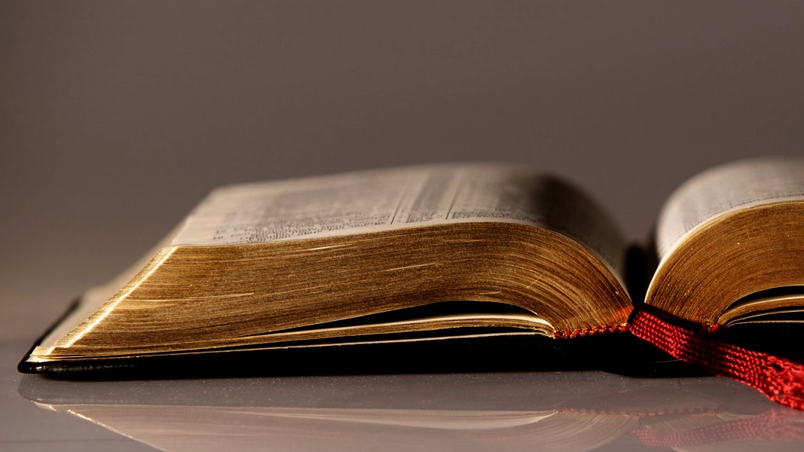
Welcome to
Our Sunday School
We’ll start at 9:07
visit OurSundaySchool.com for more about our class

Slide 2
Today’s class (pages 49-58)
Philippians 1:12-14

Slide 3
Philippians 1:12-14 (CSB)
Now I want you to know, brothers and sisters, that what has happened to me has actually advanced the gospel, so that it has become known throughout the whole imperial guard, and to everyone else, that my imprisonment is because I am in Christ. Most of the brothers have gained confidence in the Lord from my imprisonment and dare even more to speak the word fearlessly.

Slide 4
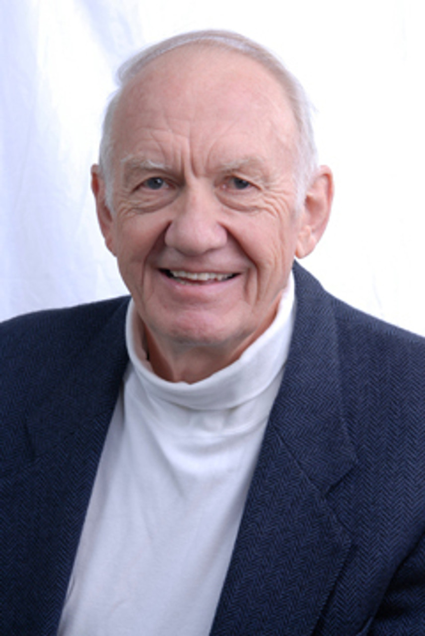
Dr. Gordon Fee Most remarkable about this opening reflection (vv. 12-18a) is how little it says about Paul personally. See esp. Col 4:7-8; cf Eph. 6:21-22.

Slide 5
Today’s class (pages 49-58)
Philippians 1:12-14

Slide 6
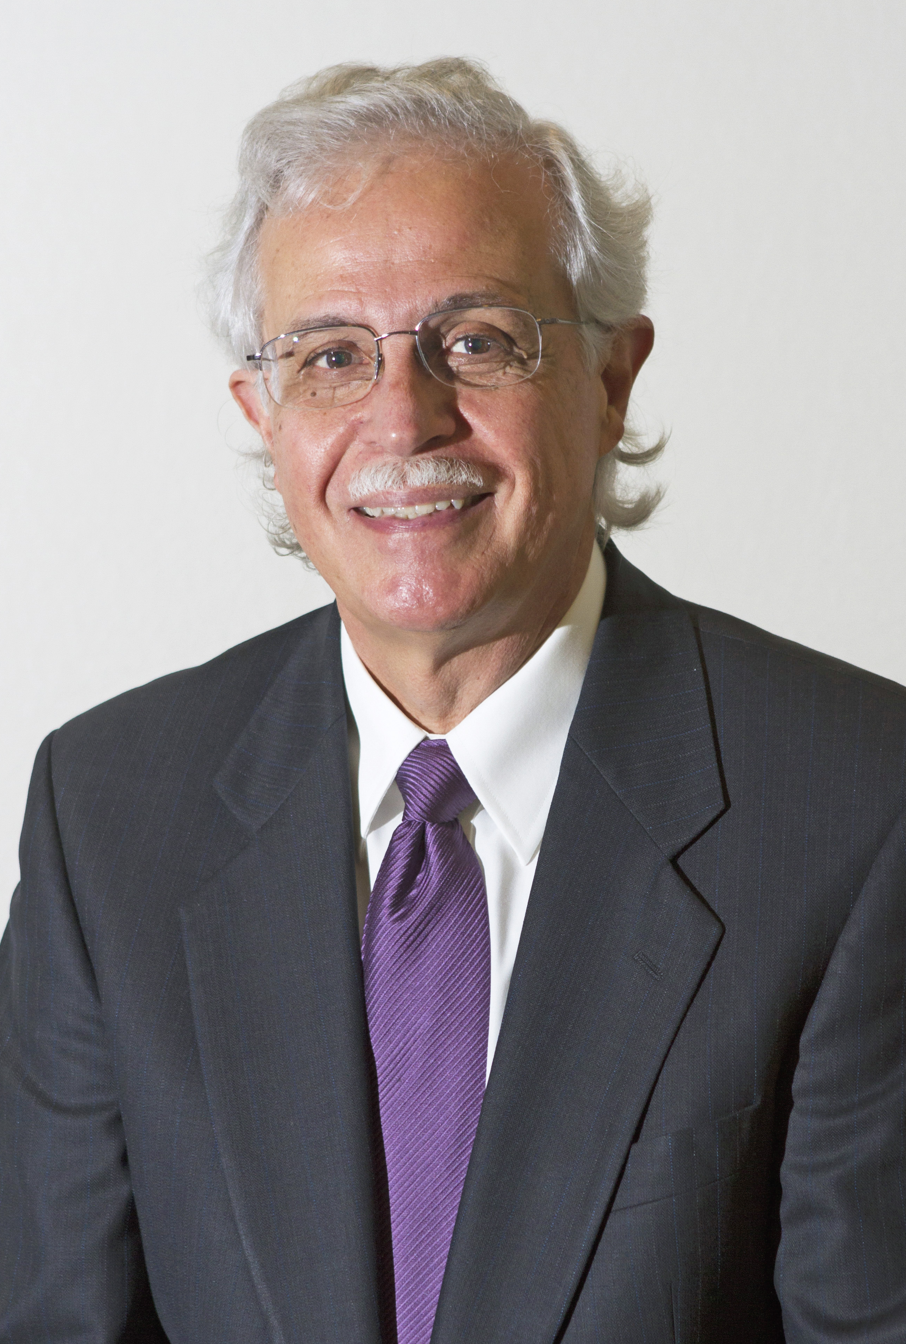
Dr. Moises Silva Contemporary missionary letters look very much like Phil. 1:12-26.

Slide 7
Today’s class (pages 49-58)
Philippians 1:12-14

Slide 8
Dr. Gordon Fee That the vocative adelphos means “brothers and sisters” in the Pauline letters is made plain from Phil 4:1 and 2, where Paul uses this vocative and then specifically addresses to women.

Slide 9
Today’s class (pages 49-58)
Philippians 1:12-14

Slide 10
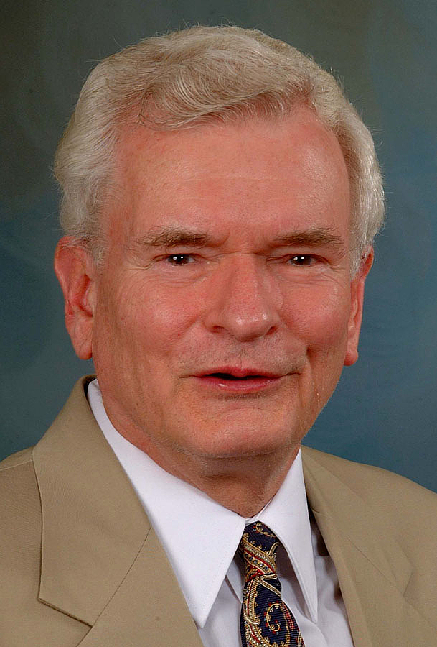
Dr. John Reumann It referred (1) to the individual’s moral progress in virtue, and (2) to progress in Greek science, technology, and culture and the rise to power by Rome.

Slide 11
Today’s class (pages 49-58)
Philippians 1:12-14

Slide 12
Dr. Moises Silva The apostle, however, did not merely say that the gospel had continued to make progress in spite of adversity…

Slide 13
Dr. Moises Silva rather, the adversity itself had turned out for the advancement of the gospel.

Slide 14
Today’s class (pages 49-58)
Philippians 1:12-14

Slide 15
Dr. Gordon Fee This phrase tends to cut the ground from under hypotheses of either and Ephesian or Caesarean provenance for this letter, since…

Slide 16
Dr. Gordon Fee (1) the guard cannot be demonstrated ever to have existed in Ephesus and (2) Herod’s praetorium in Caesarea was scarcely of a size to call for this emphasis.

Slide 17
Today’s class (pages 49-58)
Philippians 1:12-14

Slide 18
Dr. Gordon Fee Although they would have guarded Paul around the clock, they would also have given him access to visitors, to the writing of letters, and to other routine matters…

Slide 19
Dr. Gordon Fee Since they would rotate… Paul would have had access to several—or many—of them, from whom eventually “the whole guard” would have known the reason for his bonds.

Slide 20
Today’s class (pages 49-58)
Philippians 1:12-14

Slide 21
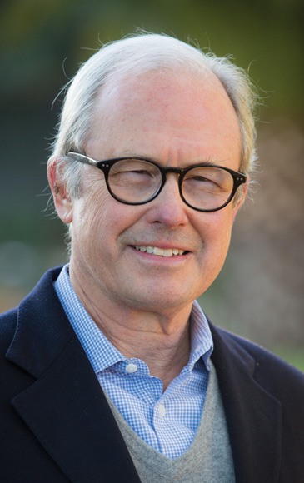
Dr. G. Walter Hansen Paul’s reference to the palace guard points to the most elite group of Roman soldiers, who served as a special bodyguard for Caesar…

Slide 22
Dr. G. Walter Hansen This group of 9,000 elite soldiers sometimes exerted control over Caesar himself. In fact, they deposed and promoted Caesars…

Slide 23
Dr. G. Walter Hansen After they assassinated Caligula, they put Claudius on the throne. Later they guided the direction of Nero’s reign.

Slide 24
Today’s class (pages 49-58)
Philippians 1:12-14

Slide 25
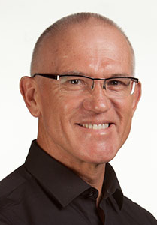
Dr. Mark Keown The whole situation would also have been laced with danger. Paul was not in a western prison but in the Nero-dominated heart of the Roman Empire…

Slide 26
Dr. Mark Keown speaking of and praying to the Roman-killed Jewish rebel Jesus as Lord, Savior, and Son of God, while chained to Roman soldiers who served Nero.... There is also some irony here…

Slide 27
Dr. Mark Keown with Paul a soldier and ambassador of God imprisoned, but the gospel advancing among the “enemy” forces as he shares Christ, and his “fellow-soldiers” like Epaphroditus preach the gospel in the city.

Slide 28
Today’s class (pages 49-58)
Philippians 1:12-14

Slide 29
Dr. Moises Silva [This is] Paul’s recognition that he is sharing in Christ’s suffering.

Slide 30
Today’s class (pages 49-58)
Philippians 1:12-14

Slide 31
Dr. Mark Keown Modern readers need to consistently remind themselves of the backdrop of this and the developing situation in Rome. Nero‘s lunacy was peeking and it would not be long…

Slide 32
Dr. Mark Keown before the Christian church would be blamed for Rome’s destruction by fire. As such, a renewed commitment to gospel proclamation was potentially dangerous.

Slide 33
Today’s class (pages 49-58)
Philippians 1:12-14

Slide 34
Prayer Time
Write down your prayer requests (on the Weekly Update or in the comments)
Lean in, engage, and pray for someone not with you
Go worship

